Slide 1
DS 5110 – Big Data Systems Midterm Review
Team 2 – Isidro Pride, Abhinandan Mekap, John Le

Slide 2
Introduction
For the first part of the project, we set up step functions to run FMI lambda functions.
We tested the effect of parallel lambda functions on the time benchmarks of these functions
Currently, no external dataset is being used

Slide 3
Step Functions
Step functions are represented as state machines and tasks.
State machines are also referred to as workflows and consists of several steps or "states"
Specific AWS services or API's can be called to perform tasks

Slide 4
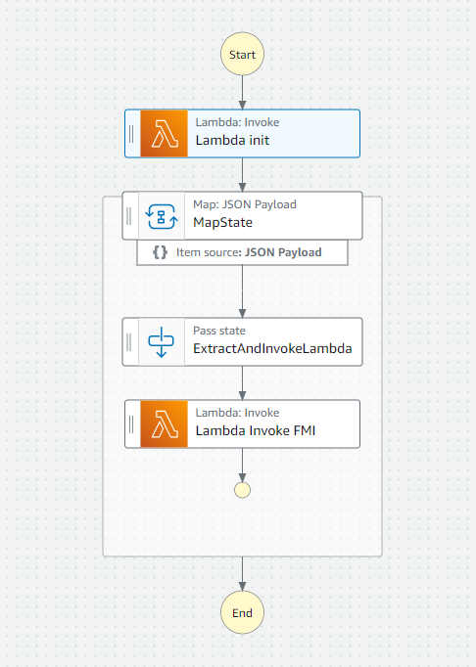
Pre-Built State Machine
This is the pre-built state machine we used
As you can see, it goes through an initial lambda function that takes an input payload, a map state, pass state, and a final lambda function that takes the proper generated payloads

Slide 5
Pre-Built State Machine
Workflow Overview
Lambda Init: Starts and processes input
Map State: Iterates over the input allowing parallel execution
Pass State: Acts as a connector and passed data through to the next function
Lambda Invoke: Processes results for the final output

Slide 6
Experimental Design
Created three State Machine trials/executions
Made use of the pre-existing MyStateMachine-e5ydt2afc state machine, as shown in the previous slide
Updated 'world_size' parameter within the 'Lamda Init' function for our trials, specifically using 2, 8, and 32

Slide 7
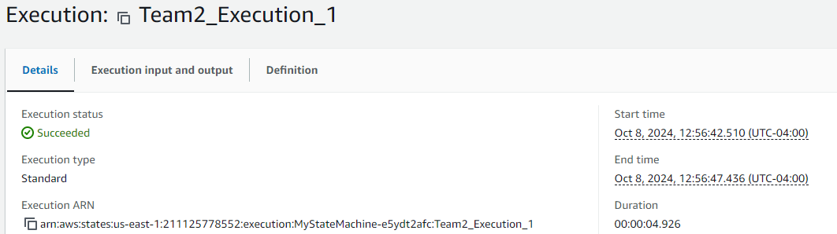
Execution Success/Failure
All three executions succeeded without failure

Slide 8
Results - Time
Number of Lambda Functions | Run Time (seconds)
2 | 4.926
8 | 6.573
32 | 6.615

Slide 9
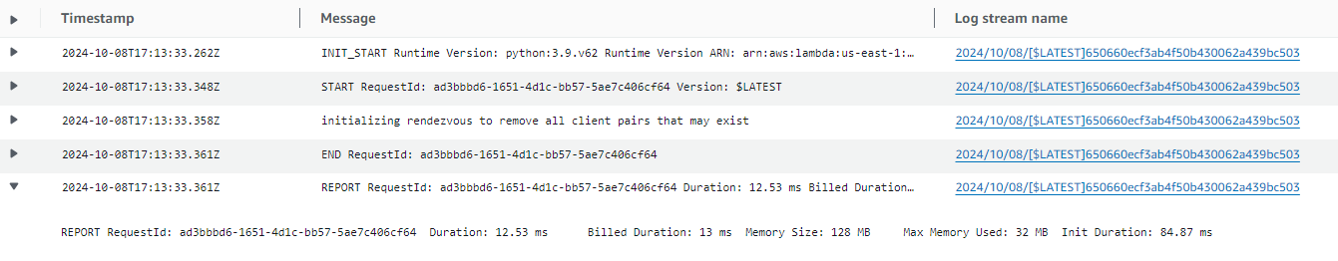
CloudWatch Results
Obtained some information such as billed duration and maximum memory used

Slide 10
Results - CloudWatch
Number of Lambda Functions | Duration (ms) | Billed Duration (ms) | Max Memory Used (MB)
2 | 17.50 | 18 | 32
8 | 12.53 | 13 | 32
32 | 17.62 | 18 | 33

Slide 11

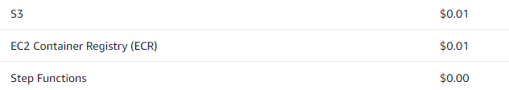
Costs
Used billing and cost management to obtain some daily costs

